Slide 1



Targeted Metabolomics Data Analysis: Unlocking Insights with Machine Learning, AI and Statistics
Wishart Node
Day 2 – Lecture 2.3
June 11-14, 2024
Barcelona, Spain

Slide 2
Agenda (Day 2)
Time | Activity
8:30 – 9;00 | Arrival
9:00 – 10:30 | The MEGA Metabolomics Assay
10:30 – 11:00 | Coffee
11:00 – 12:00 | Introduction to LC-AutoFit
12:00 – 13:00 | Lab: Running LC-AutoFit on Real Data
13:00 – 14:00 | Lunch
14:00 – 15:30 | Lab: Running LC-AutoFit on Real Data
15:30 – 16:00 pm | Coffee
16:00 – 17:00 pm | Biomarkers, Ratios and Reference Data

Slide 3
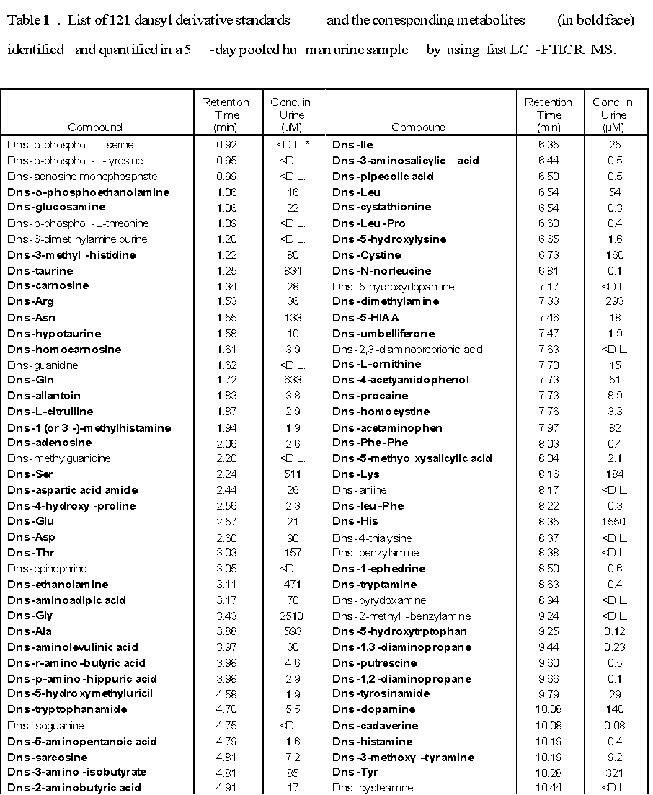
Typical Results - MEGA
Up to 650 compounds identified and quantified in serum or plasma
About 300 compounds identified and quantified in urine
Table of compound identifiers and their concentrations
How do you determine what is normal or abnormal for a given sample or metabolite?

Slide 4
Some Definitions…
Reference intervals (RIs) are defined as the 2.5th and 97.5th percentiles of an analyte measured in a healthy reference population (average +/- 3 SD)
Reference intervals generally take into account age, sex, time of collection, fasting status, and analytical methodology
Reference intervals are used to flag abnormal results and to prompt further follow up in clinical testing
Clinical decision limits (CDLs) are determined based on clinical outcome studies and are sometimes more relevant for compounds like vitamin D and lipoprotein-bound lipids

Slide 5
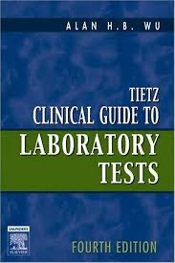
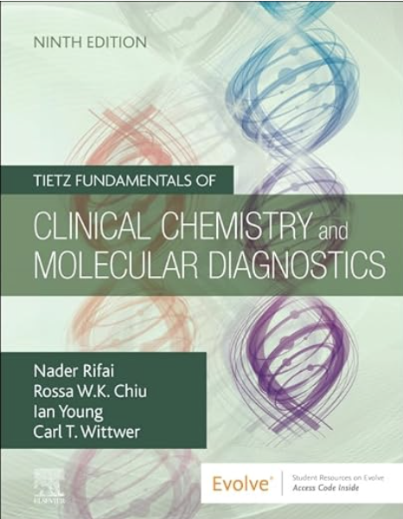
Finding Reference Intervals/Values
You can look these up in various books and manuals
Some of the better-known reference texts are the Tietz guide(s) to clinical laboratory tests
These are based on books and reference tables originally compiled by Norbert Teitz
Teitz started the first M.S. degree program in clinical chemistry in the United States in the 1960’s
This program was subsequently expanded into one of the first Ph.D. programs in clinical chemistry

Slide 6

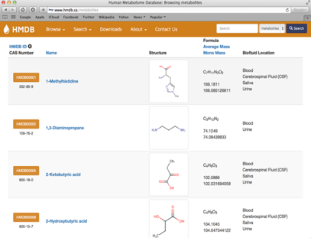
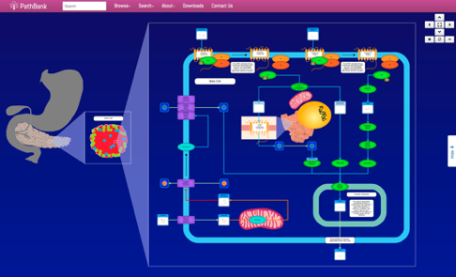
Another Method: The Human Metabolome Database (HMDB)
A comprehensive metabolomics database established in 2006 to contain detailed information about human metabolites, their structures, names, synonyms, physical properties, descriptions, concentrations, disease associations, functions, pathways and reference MS and NMR spectra
HMDB currently has reference (healthy) metabolite concentration data on thousands of metabolites in many biofluids and tissues
Also has metabolite biomarker data on >600 human diseases
http://www.hmdb.ca

Slide 7
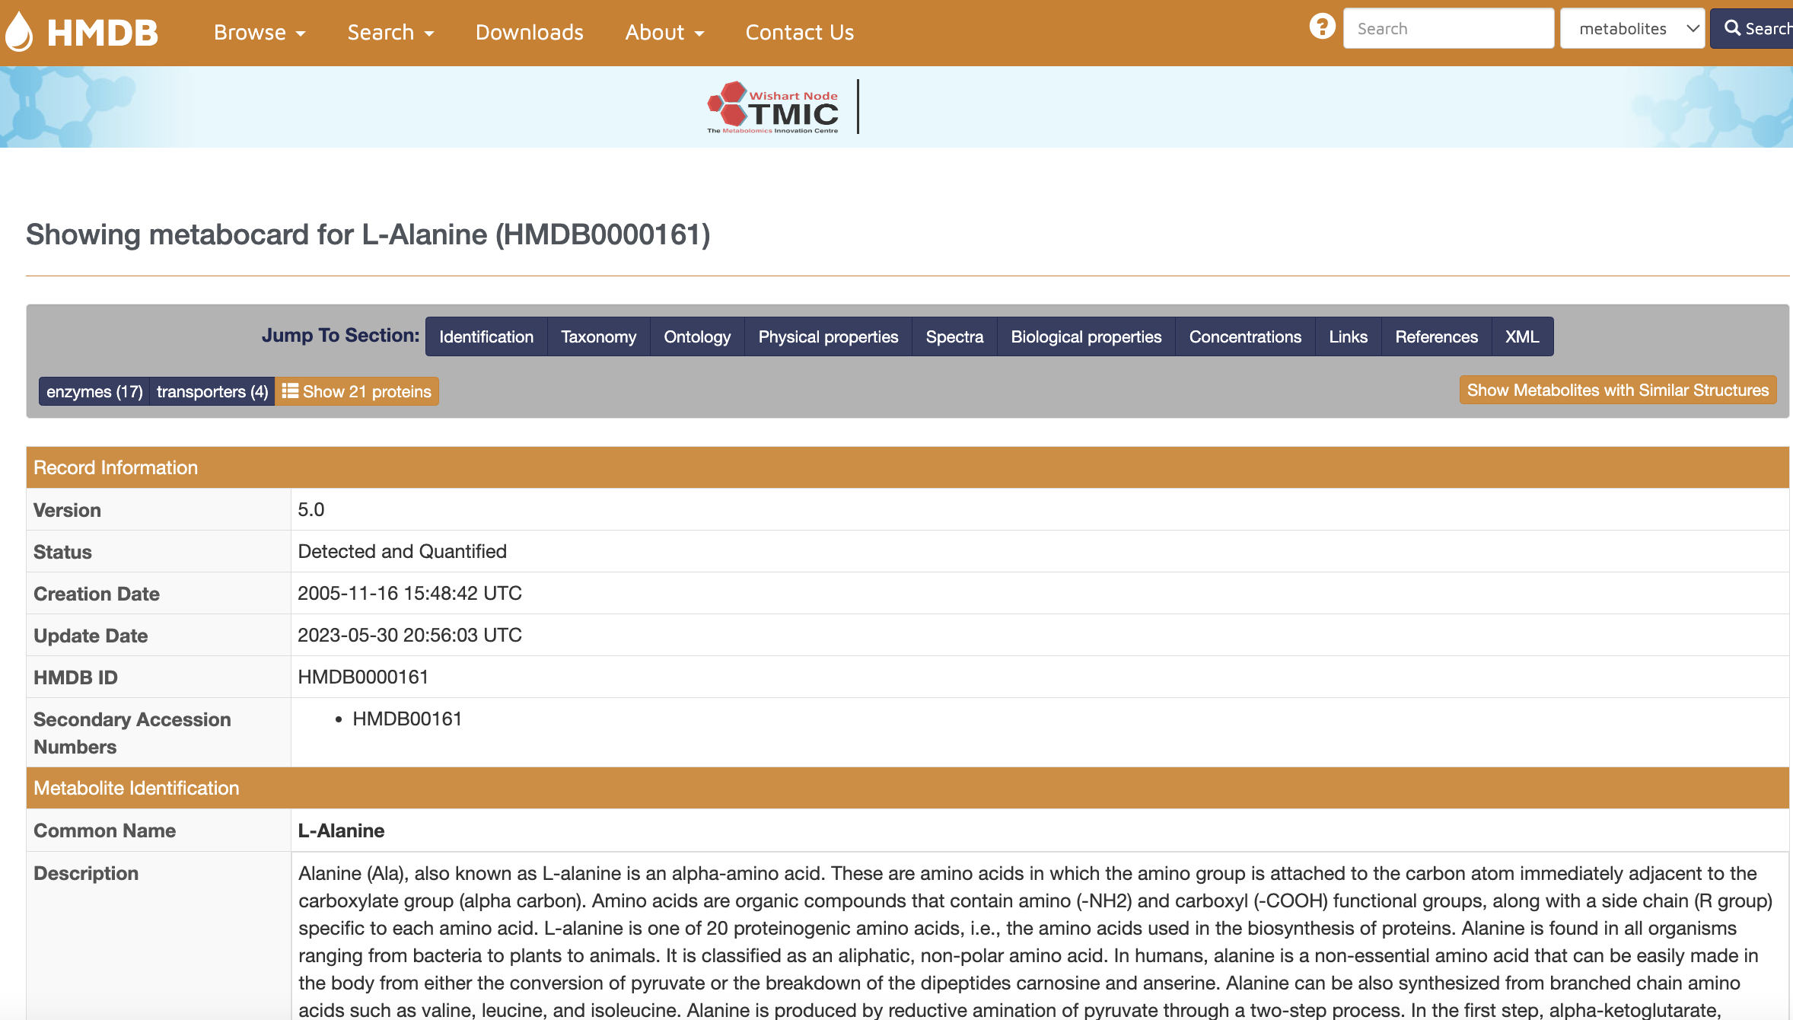
Looking Up Reference Values in HMDB

Slide 8
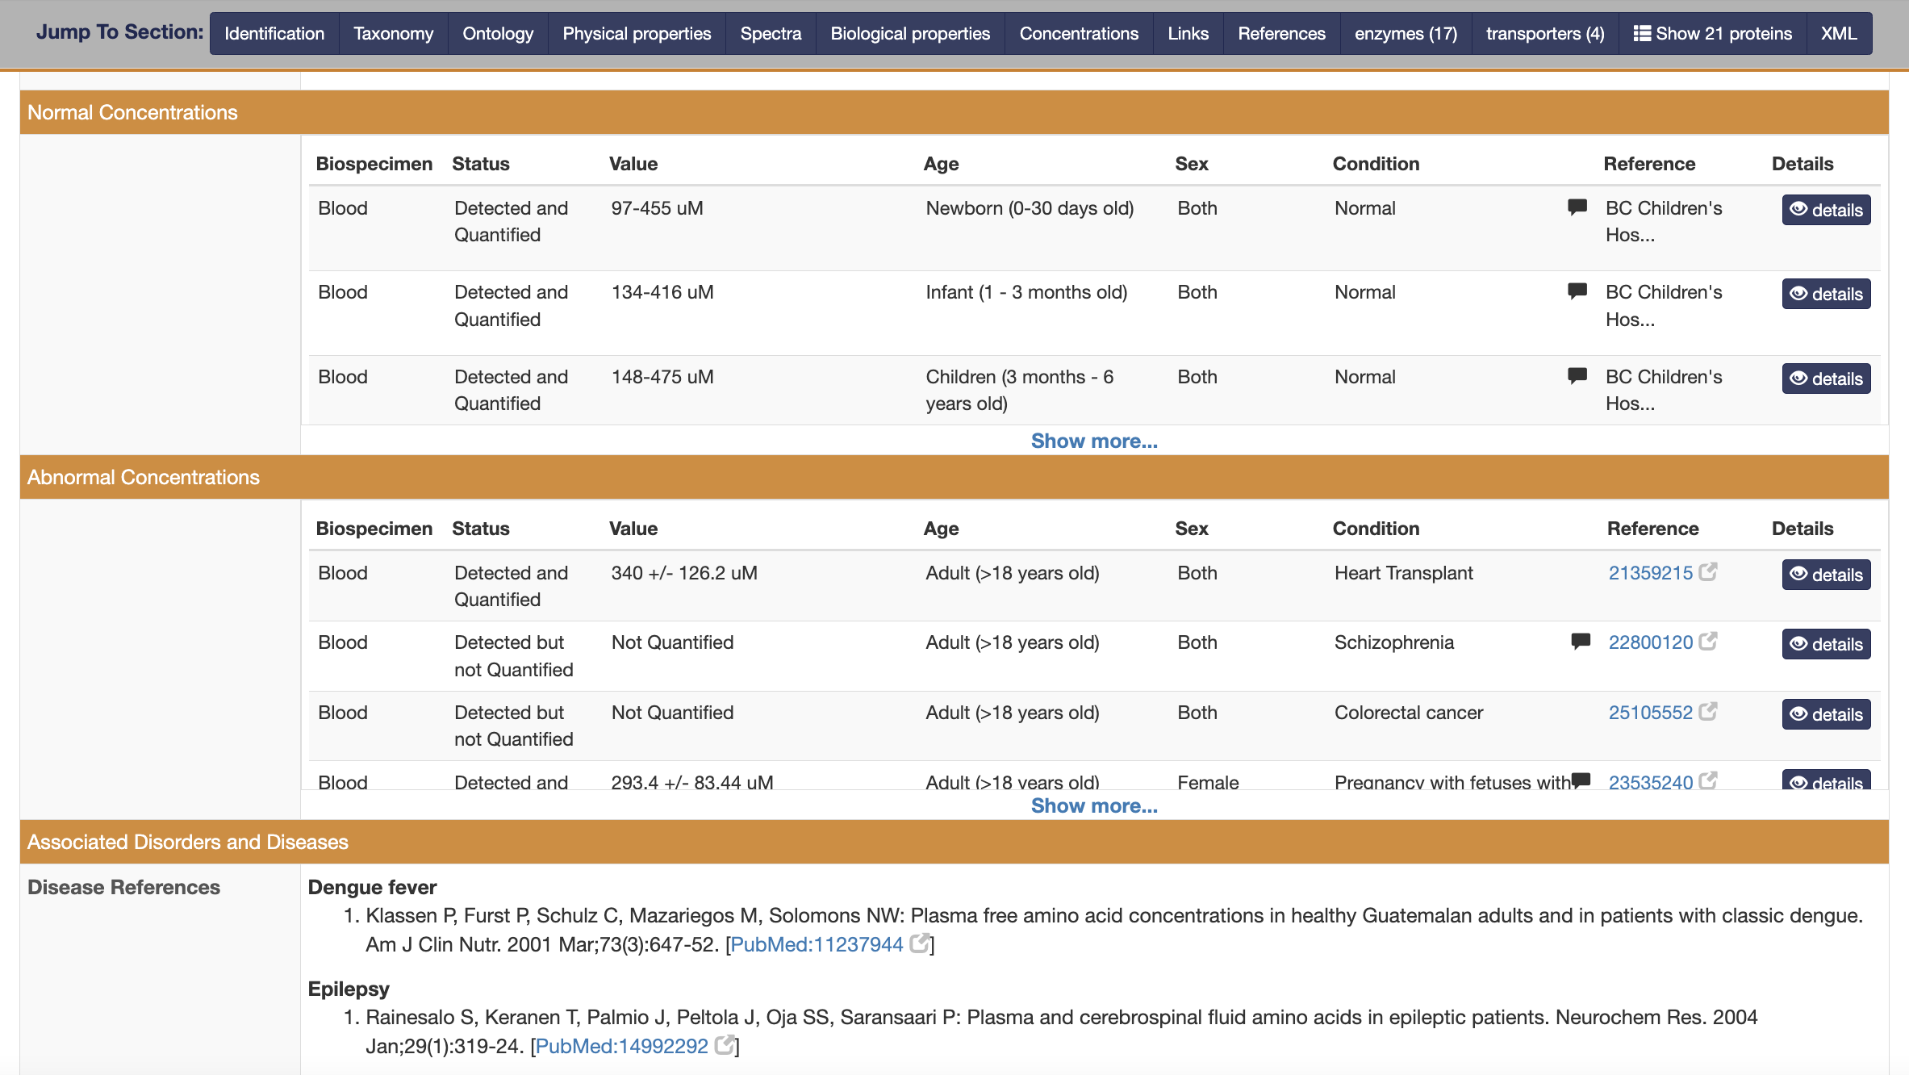
Looking Up Reference Values in HMDB

Slide 9
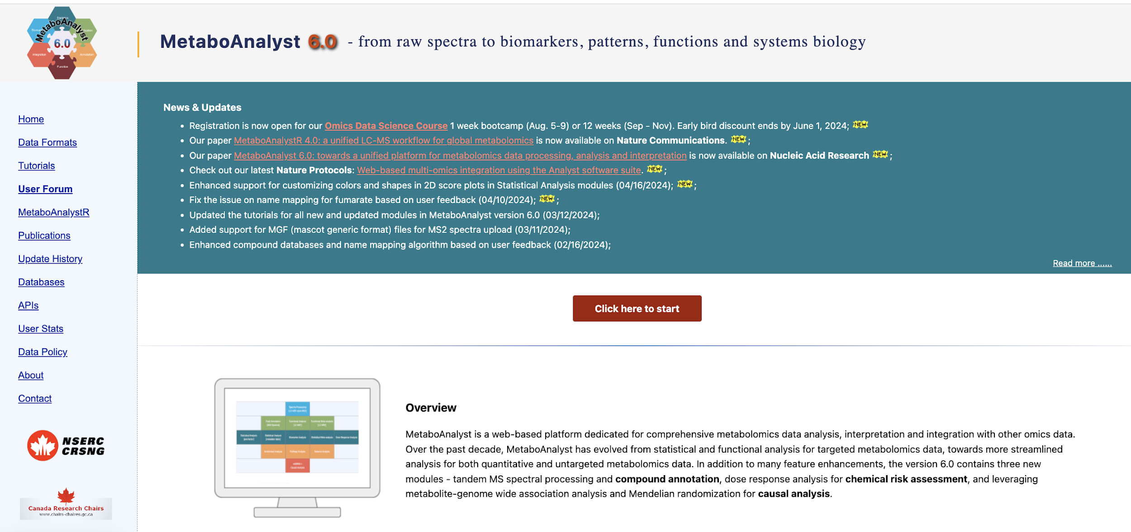
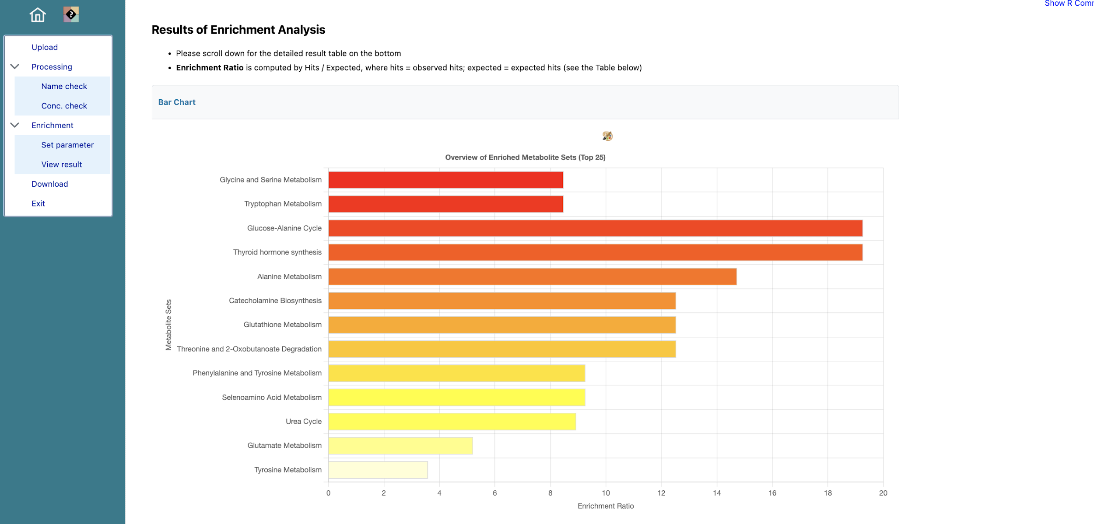
Another Method: MetaboAnalyst
MetaboAnalyst is a metabolomics data processing webserver that supports many kinds of analyses
The ”Enrichment Analysis” module allows users to compare their results with reference concentrations for different biofluids and associate those differences to specific diseases, pathways or body compartments
SSP (Single Sample Profiling) and ORA (Over Representation Analysis) are particularly useful – We’ll learn about these tomorrow
https://metaboanalyst.ca

Slide 10
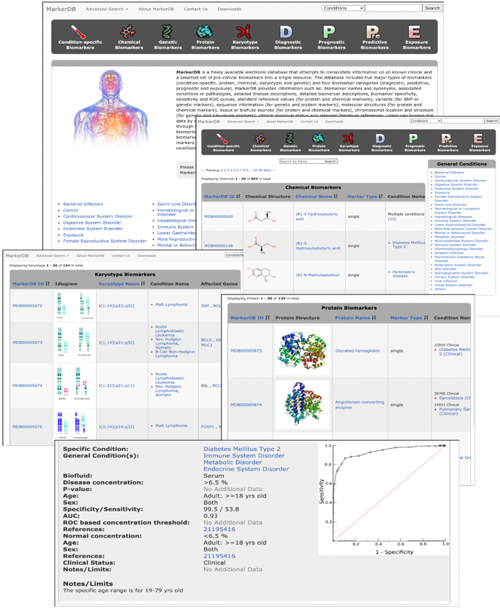
Another Method: MarkerDB – The Biomarker Database
MarkerDB was established to house and display authoritative biomarker data (thresholds, sensitivity, specificity, ROC curves) for clinically approved or clinically interesting biomarkers
Contains thousands of biomarkers and hundreds of biomarker panels for a wide range of diseases or conditions
Includes metabolomic, exposure, toxicity, proteomic, GWAS, mutational and chromosomal biomarkers
https://markerdb.ca

Slide 11
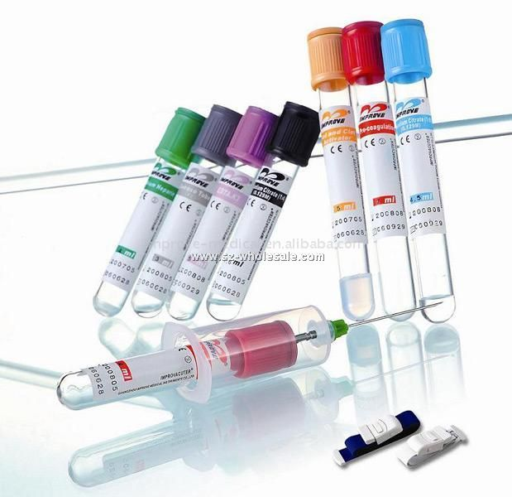
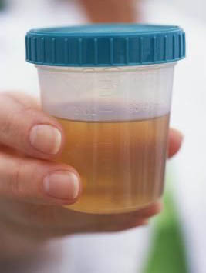
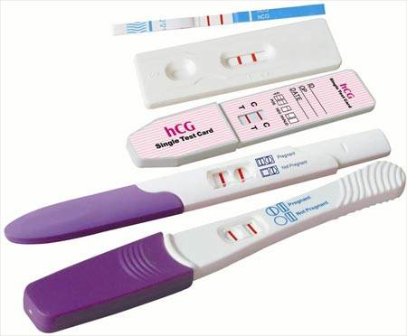
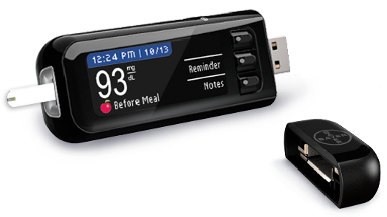
What’s A Biomarker?
It is a substance or molecule that can be objectively measured and evaluated as an indicator or predictor of normal biological processes, pathogenic processes or pharmacologic responses to a therapeutic intervention
Molecular entities (proteins, genes, metabolites) that can be used to diagnose, monitor or predict disease

Slide 12
Types of Biomarkers
Diagnostic
Do you have a given disease/condition
Prognostic
How well will you do with this disease/condition
Predictive
Odds of getting a given disease/condition
Marker of Response or Toxicity
Response to drug/food/toxin intake
Marker of Exposure
Indication of drug/toxin/food consumption

Slide 13

Traditional Clinical Chemistry Biomarkers
Glucose (> 7 mM – diabetes)
Creatinine (> 110 uM – kidney damage)
Cholesterol (> 5.2 mM – CVD risk)
Triglycerides (> 1.8 mM – CVD risk)
Uric acid (> 0.5 mM – gout)
T₄ Thyroxine (>160 nM – hyperthyroidism)
T₄ Thyroxine (< 60 nM – hypothyroidism)
Phe/Tyr Ratio (> 2.5 – PKU)

Slide 14

Nothing in Biology is Ever Black & White
Most analytes when measured across populations have a distribution of concentrations
Normal individuals may have one distribution centred about one mean, while sick individuals may have another distribution centered about a different mean
Normal Sick

Slide 15
Nothing in Biology is Ever Black & White
Easy to choose
a cutoff value
Hard to choose
a cutoff value
Normal Sick
Normal Sick

Slide 16
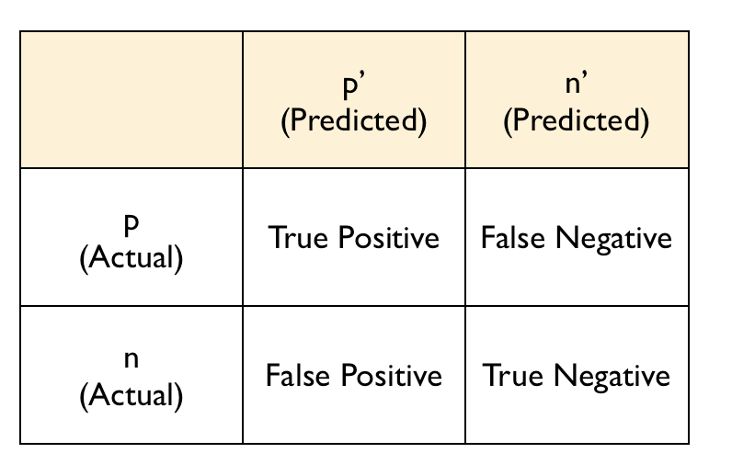
Biomarker Math
Basic concepts
True positives (TP)
True negatives (TN)
False positives (FP)
False negatives (FN)
Sensitivity (Sn)
Specificity (Sp)
Sn (sensitivity) = True positive rate
Sp (specificity) = True negative rate
Confusion
Matrix

Slide 17
Evaluating Binary or Class Predictions
TP FP TN FN TP FN TN
Actual
Predicted
Sensitivity Measure of the % of false negative results (sn = 0.996
means 0.4% false negatives)
Specificity Measure of the % of false positive results
Precision Measure of the % positive results

Slide 18
Sensitivity/Specificity
TP FP TN FN TP FN TN
Actual
Predicted
Sensitivity or Recall Sn=TP/(TP + FN)
Specificity Sp=TN/(TN + FP)
Precision Pr=TP/(TP + FP)
Sensitivity is the True Positive rate, high FN means low Sn
Specificity is the True Negative rate, high FP means low Sp
Screening tests need high sensitivity for treatable diseases
Surgical decision tests need high specificity

Slide 19
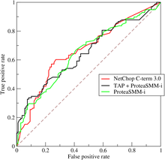
How to Measure sn/sp Together?
ROC (receiver operating characteristic curve) -- a graphical plot of the sensitivity, or true positive rate, vs. false positive rate, for a binary classifier system as its discrimination threshold is varied
Often used to assess biomarker predictions
The ROC curve was first developed by
electrical engineers and radar engineers
during World War II for detecting enemy
planes flying over England
True positive = a ‘hit’
False negative = a ‘miss’
False positive = a ‘false alarm’
True negative = correct rejection

Slide 20

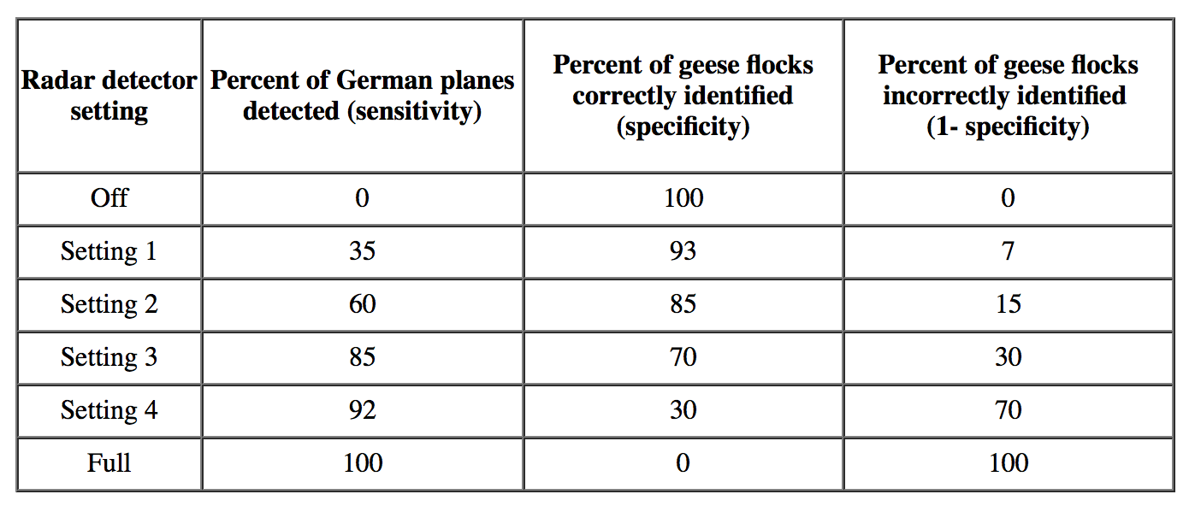
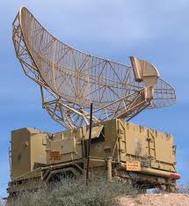
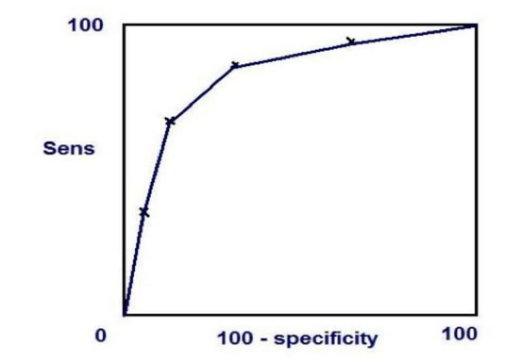
Calculating a ROC Curve

Slide 21
ROC Curves
A good ROC curve should look like a logarithmic curve or ideally like an upside-down “L” or gamma Γ
A poor ROC curve would be a simple straight line with a slope of 1
The area under an ROC (AUROC) curve is a good measure of the quality of a biomarker or some other discriminator
AUCs of >0.75 are good, AUCs of 0.5 are terrible, AUCs of 1.00 are perfect

Slide 22
Area Under ROC Curve (AUC)
100%
100%
TPR
AUC = 90%
AUC = 70%
TPR
A good test
A poor test
0%
0%
0%
FPR
100%
0%
FPR
100%
100%
100%
AUC = 100%
TPR
TPR
Best test
AUC = 50%
Worst test
0%
0%
0%
FRR
100%
0%
FPR
100%

Slide 23
Calculating ROC Curves
Imagine two populations, one healthy (control) and one with diabetes (diseased)
Imagine you are measuring a single metabolite (say glucose) in serum
The healthy population will have a distribution of glucose (say from 3 mM to 7 mM)
The diabetic population will have a distribution of glucose (say from 6 mM to 10 mM)
This is what the distribution of glucose will look like

Slide 24
Calculating ROC Curves
Healthy
Diabetic
Call these patients “negative”
Call these patients “positive”
True Positives (TP)
True Negatives (TN)
False Positives (FP)
False Negatives (FN)
Test Results
Control
Disease
Sn = TP/(TP + FN) Sp = TN/(TN + FP)

Slide 25
Calculating ROC Curves
100%
Tradeoff between sensitivity and specificity
True Positive Rate (sensitivity)
0%
0%
False Positive Rate
(1-specificity)
100%

Slide 26
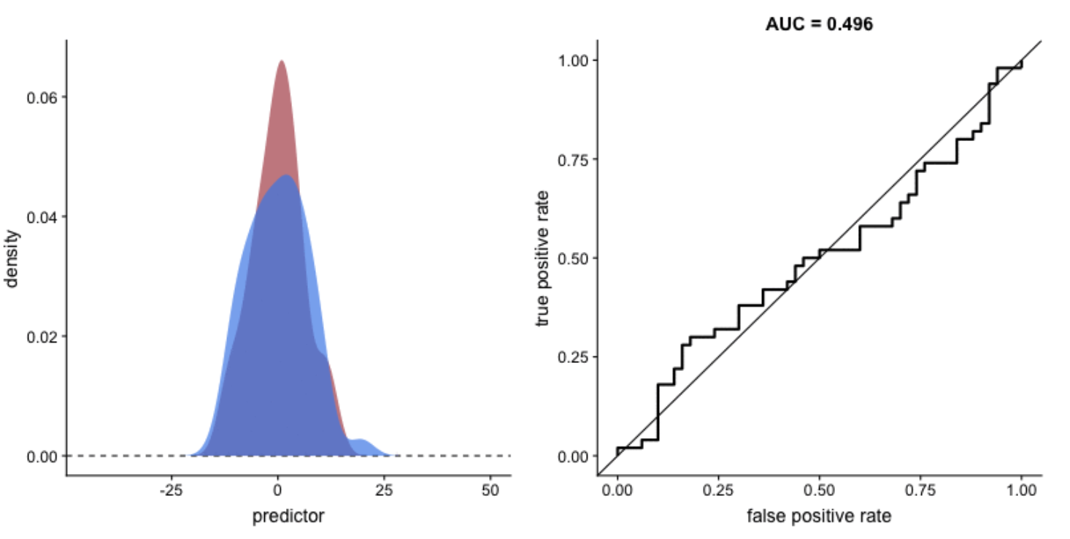
ROC Curve with Fully Overlapped Distrbutions

Slide 27
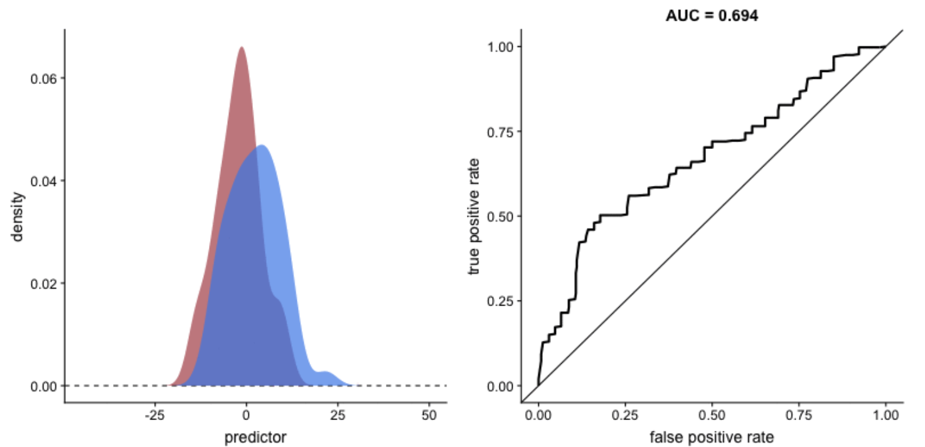
ROC with Partially Overlapped Distributions

Slide 28
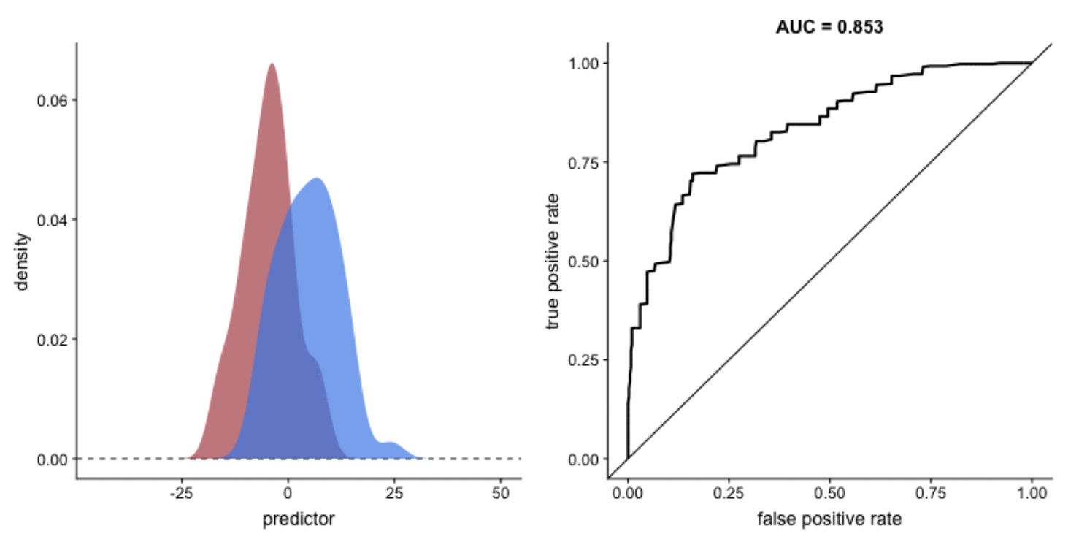
ROC with Partially Overlapped Distributions

Slide 29
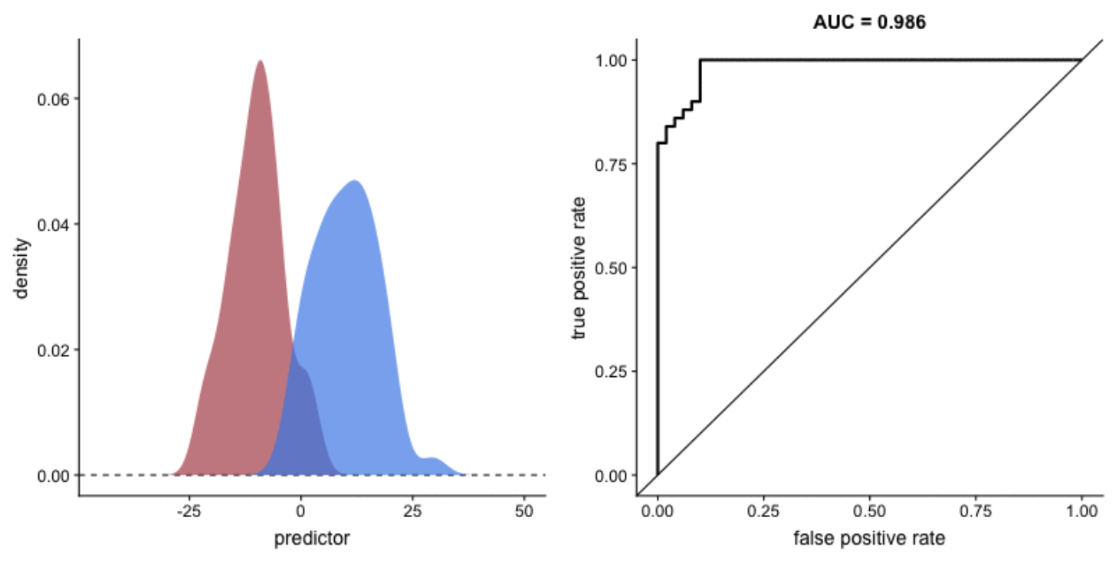
Better Separation

Slide 30
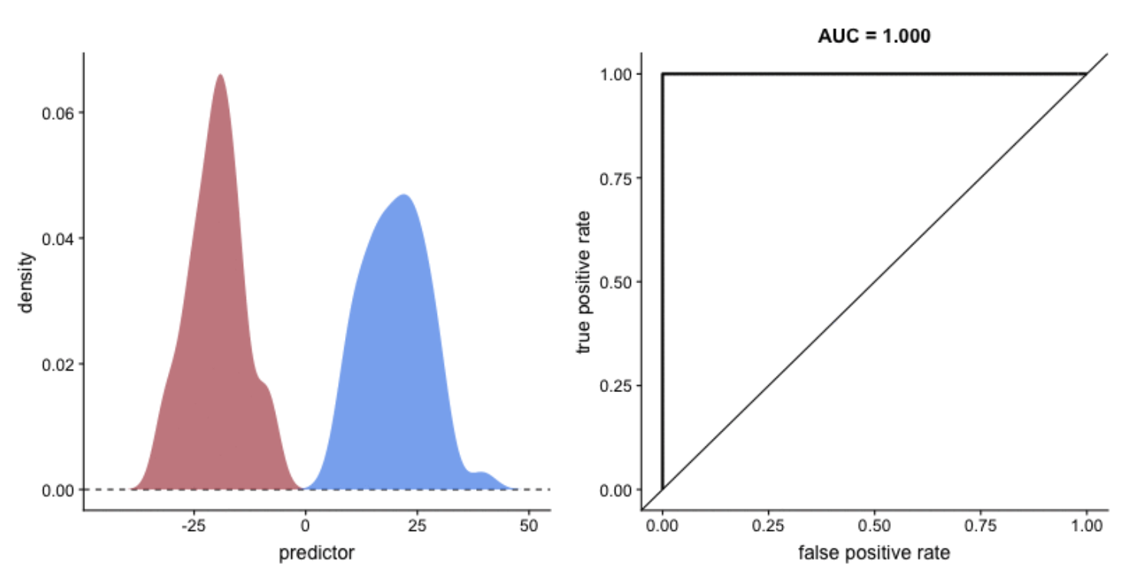
Perfectly Separated Populations

Slide 31
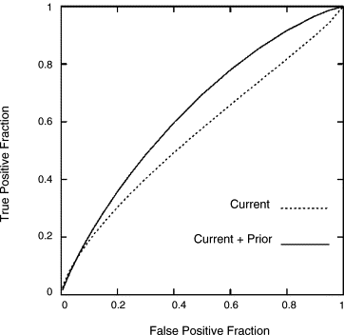
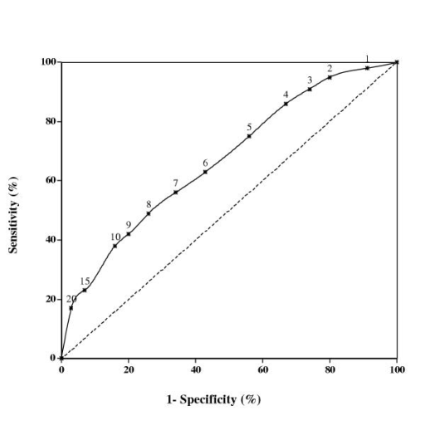
AUCs of Common Single Marker Tests
Mammogram (Benign vs. Malignant)
PSA Test
AUC = 0.53
AUC = 0.65

Slide 32
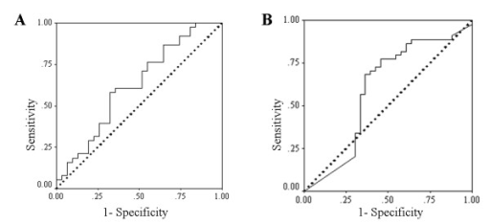
AUCs of Common Single Marker Tests
Cancer (CEA)
Cancer (CA 19-9)
AUC = 0.63
AUC = 0.63

Slide 33
Multi-marker Panels
Historically we have stuck with the idea one biomarker = one disease
This limits accuracy, precision sensitivity and specificity of the biomarker
Omics technologies now suggest many biomarkers = one disease
This improves accuracy, precision, sensitivity and specificity of the diagnosis and/or prediction
The problem is the math gets more complicated

Slide 34

From Many to One “Panel”
Need to use multivariate statistics, logistic regression or machine learning to develop a biomarker panel that consists of 2 or more biomarkers together
Need to assess the biomarker panel (and accompanying equation or model) using Receiver Operating Characteristic (ROC) curves

Slide 35
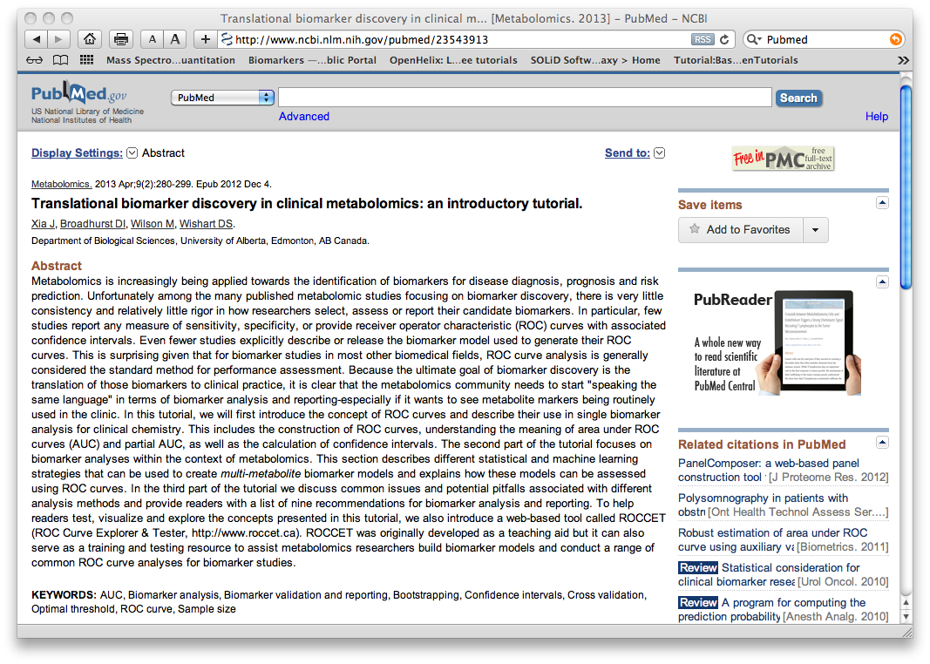
Biomarker How To’s

Slide 36
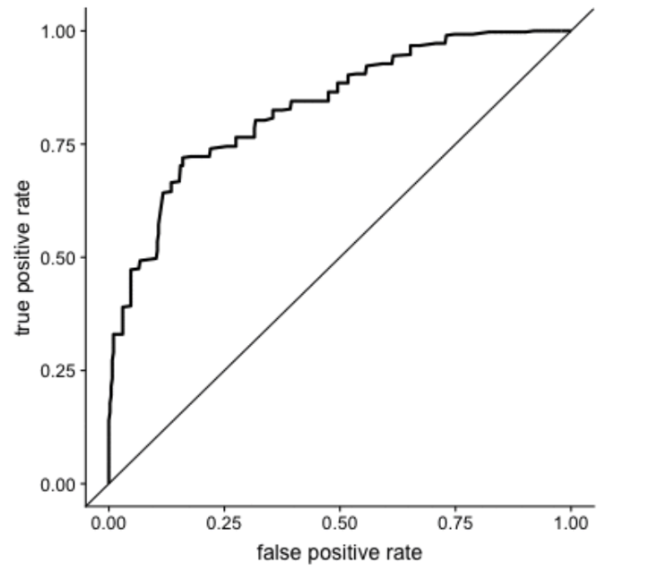
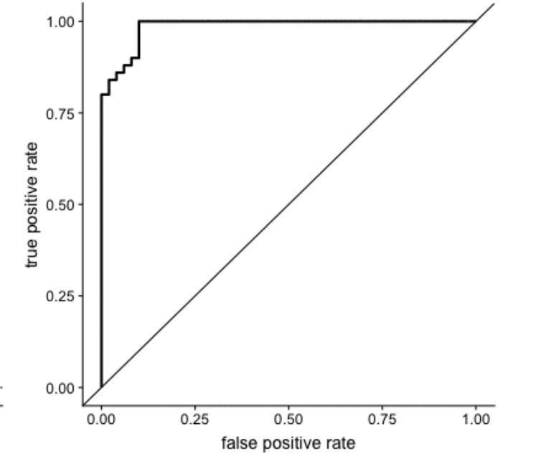
Using Two Markers
Marker 1
Combined Biomarker
ROC Curve
ROC Curve
Marker 1
Normal Sick
Marker 2
ROC Curve
Marker 2
Sick Normal

Slide 37
How?
Marker 1 Marker 2
Green +
Orange
M2/M1
Concentration Value
Blue +
Purple
Normal Sick
Sick Normal
M1/M2

Slide 38
How?
For almost every sick person where marker 1 didn’t differentiate between normal people, marker 2 did
For almost every sick person where marker 2 didn’t differentiate between normal people, marker 1 did
By calculating the ratio of marker 1 to marker 2 and vice versa, for each person in each group (healthy and sick) it is possible to create a biomarker “panel” to differentiate most sick individuals from most healthy individuals

Slide 39
Sums and Ratios
Sums and ratios can be very useful in creating useful biomarker panels
Sums and ratios of metabolites are feasible for targeted, quantitative metabolomics, but are not feasible for untargeted or non-quantitative metabolomics
This is a a key advantage of quantitative metabolomics
The MEGA assay has data on >200 sums and ratios
Metabolites sums and ratios can have real clinical meaning and useful biomarker implications
Other metabolite sums and ratios are helpful for interpreting biochemical pathways or biochemistry

Slide 40
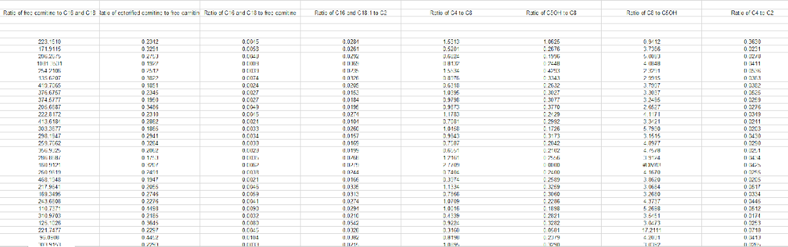
MEGA Sums and Ratios
Metabolite sums & ratios

Slide 41
Examples
Sum of Essential Amino Acids = His+Ile+Leu+Lys+Met+Phe+Trp+Thr+Val
Sum of Non-Essential Amino Acids =
Ala+Gly+Cys+Asp+Glu+Asn+Pro+Gln+Arg+Ser+Tyr
Ratio of ΣEAAs to ΣNEAAs in urine provides a measure of muscle loss and can be a marker for for conditions such as cachexia (muscle wasting in cancer and other diseases)

Slide 42
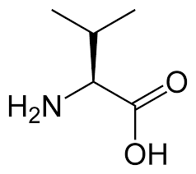
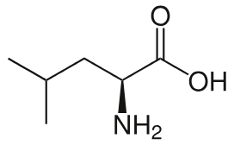
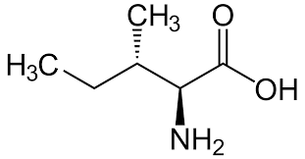
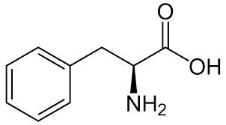
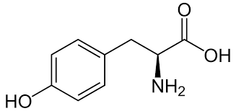
The Fischer Ratio
Fisher´s ratio (FR) is defined as sum of branched-chain amino acids (BCAAs: Leu, Ile and Val) divided by the sum of aromatic amino acids (AAA: Tyr, Phe)
BCAAs (and AAAs) tend to be elevated in patients with insulin resistance, prediabetes and NAFLD
However, for liver disease the AAAs tend to rise and BAAs tend to drop
The FR normally is about 3.5 and can drop markedly (to 0.7-0.8) in patients with chronic liver damage

Slide 43
The Phe to Tyr Ratio
Blood phenylalanine-to-tyrosine (Phe/Tyr) ratio is an important indicator of metabolic control in phenylketonuria or PKU patients
Individuals with uncontrolled PKU will have a Phe/Tyr ratio of >10 (sometimes as high as 50 or 60)
Individuals with good control over their disease (and diet) will have a Phe/Tyr ratio typically between 5-10
Normal individuals have a Phe/Tyr ratio of <2.5

Slide 44
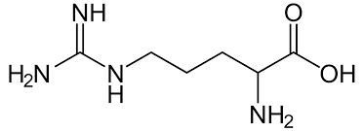
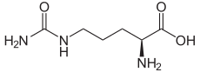
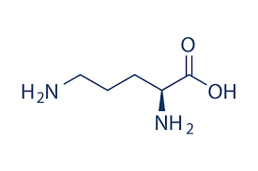
The GAB and AO Ratios
Global arginine bioavailability ratio (GABR) calculated as Arg divided by the sum of ornithine (Orn) plus citrulline (Ctn)
A related index is the arginine-to-ornithine ratio (AOr) that may reflect arginase activity
A GABR of <0.90 is indicative of type 2 diabetes
GABR and the AOr are associated with markers of endothelial dysfunction and increased risk of cardiovascular mortality

Slide 45
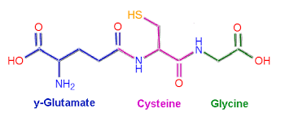
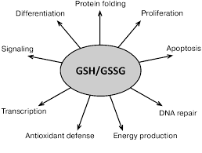
The GSG Index
The GSG index is the ratio of Glu divided by the sum of Ser and Gly
This index measures amino acids involved in glutathione synthesis
An index value higher than 0.36 is associated with twofold higher prevalence of NAFLD
The GSG index is associated with liver damage, the severity of liver fibrosis and shows a positive relation to liver enzymes, such as GGT and AST

Slide 46
Moving Beyond Sums and Ratios
It is possible to use other linear or non-linear combinations of metabolites (and sums or ratios) to create more powerful biomarker panels
It is also possible to use decision trees (if X, then Y else Z) to create biomarker panels to improve disease diagnosis
These approaches are the basis to logistic regression, PLS-DA, SVMs and other tools used for discovering biomarkers – we will learn about this tomorrow

Slide 47
Examples of Multi-marker Panels from Metabolomics (Mostly Built Using Logistic Regression)

Slide 48
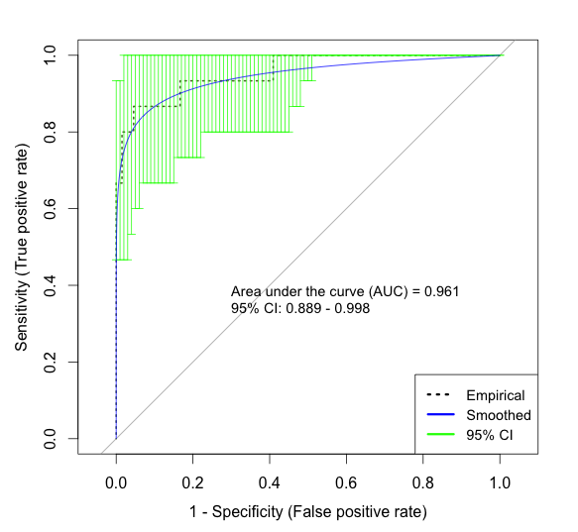
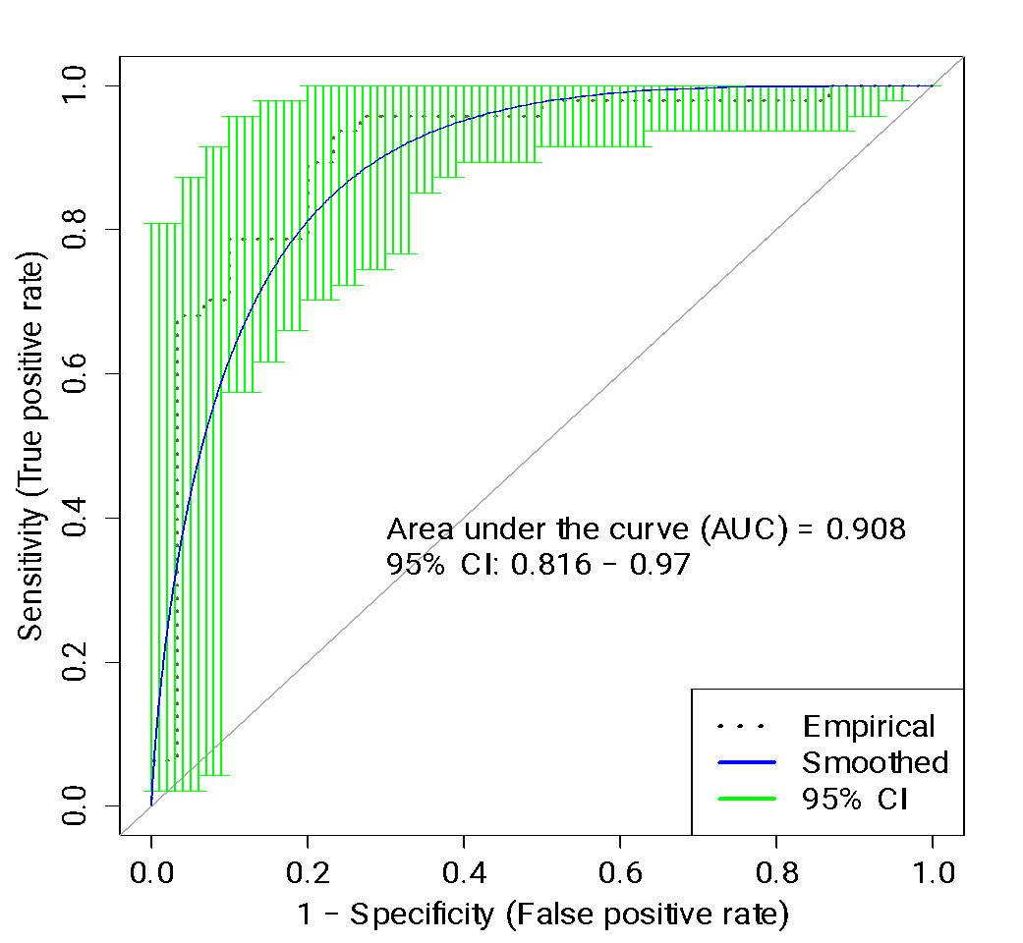
Diagnosing Transplant Rejection
Adult kidney transplant rejection
Adult Urine samples
AUC=0.96 (9 metabolites)
Pediatric kidney transplant rejection
Pediatric Urine samples
AUC=0.91 (4 metabolites)
Ho et al. Transplant Direct. 2016 May 19;2(6):e78.
Blydt-Hansen et al. Am J Transplant.2014 Oct;14(10):2339-49.

Slide 49
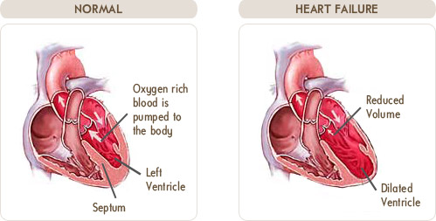
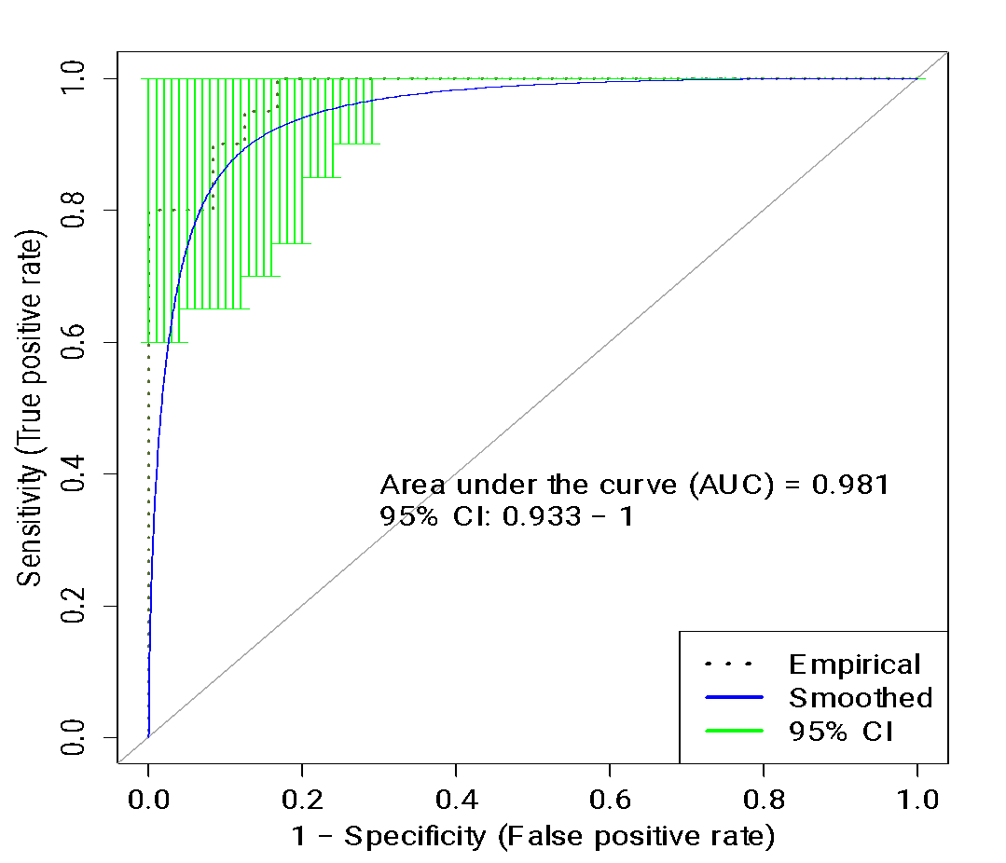
Diagnosing Heart Failure
Systolic Heart Failure vs. Diastolic Heart Failure
Adult Serum samples
AUC=0.98 (4 metabolites)
Zordoky et al. PLoS One. 2015 May 26;10(5):e0124844

Slide 50
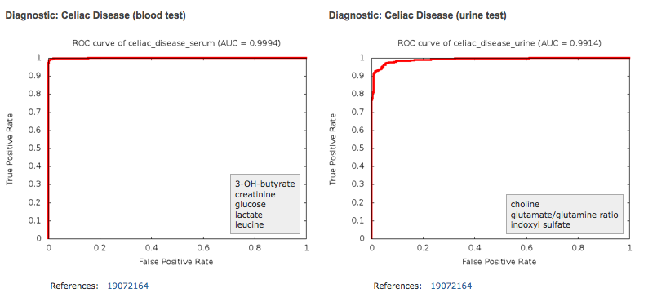
Diagnosing Celiac Disease
Celiac disease
Adult Urine Samples
AUC = 0.99 (3 metabolites)
Difficult to diagnose by symptoms
Normally requires endoscopic biopsy
Adult Urine Samples
34 cases, 34 controls
Targeted metabolomics
AUC = 0.99 using 3 metabolite
Transglutaminase blood screening test has AUC=0.91
Bertini I, Calabrò A, De Carli V, Luchinat C et al. J Proteome Res. 2009 Jan;8(1):170-177

Slide 51
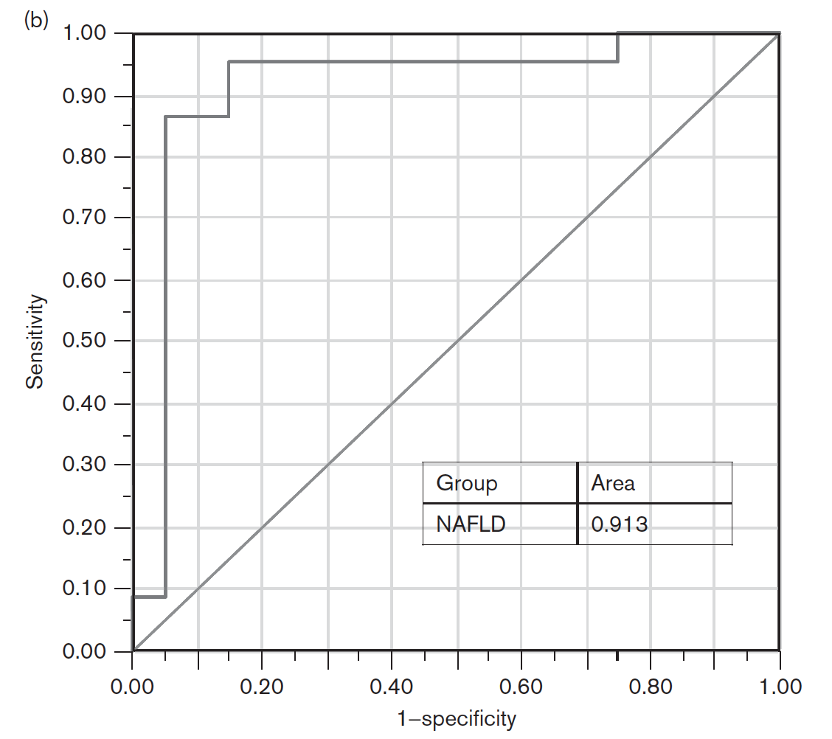
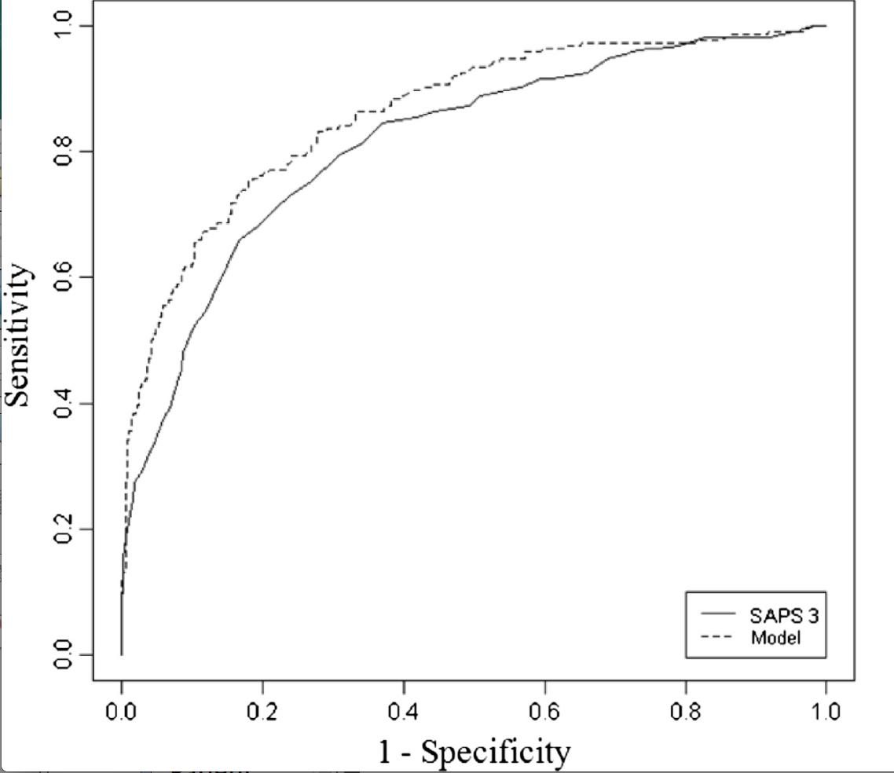
Diagnosing Liver Disease
NAFLD-Fatty Liver Disease
Children’s Breath Samples
AUC = 0.91 (4 metabolites)
Hepatitis B
Adult Urine Samples
AUC = 0.81 (4 metabolites)
Isoprene, acetone,
TMA, pentane
biotin sulfone, 5-heneicosanoate,
d-Glucosaminide, 2-methylhippurate
Akhouri, N. et al. (2014) Eur. J. Gastr. Hepatol. 26:82-87.
Zhang A et al. (2013) PLoS ONE 8(5): e64381

Slide 52
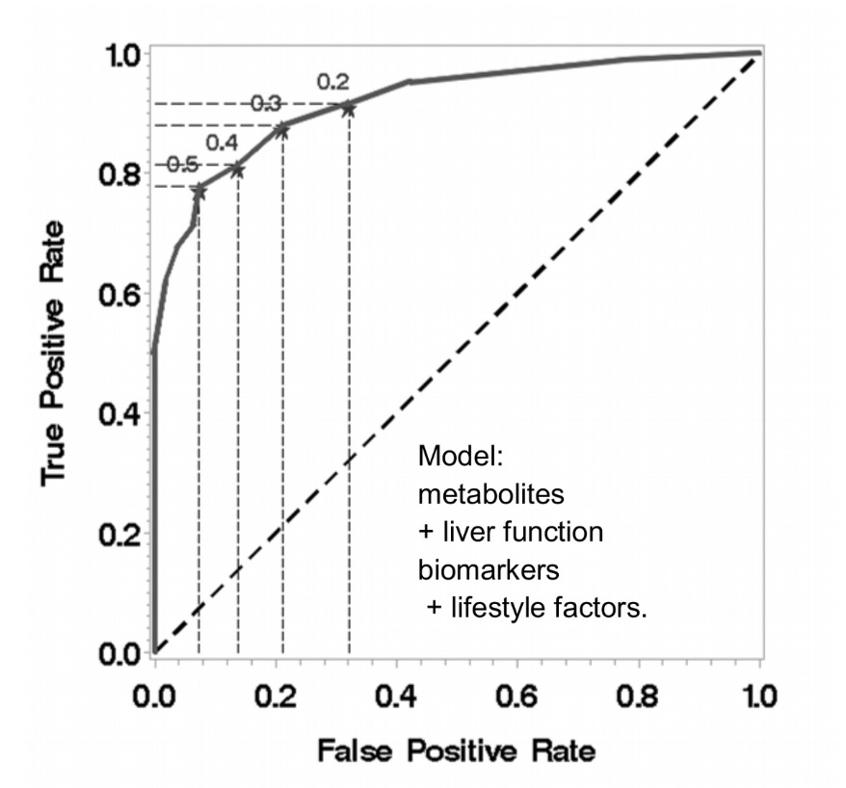
Diagnosing Liver Cancer
Adult Serum Samples
108 cases, 108 controls
MS metabolomics
AUC = 0.93 using 8 metabolites + lifestyle factors
Glutamate, glutamine, leucine, lysine, tryptophan, kynurenine, phenylalanine, tyrosine
AUC = 0.93
Stepien M. et al – Int. J. Cancer. (2016) 138:348-360.

Slide 53
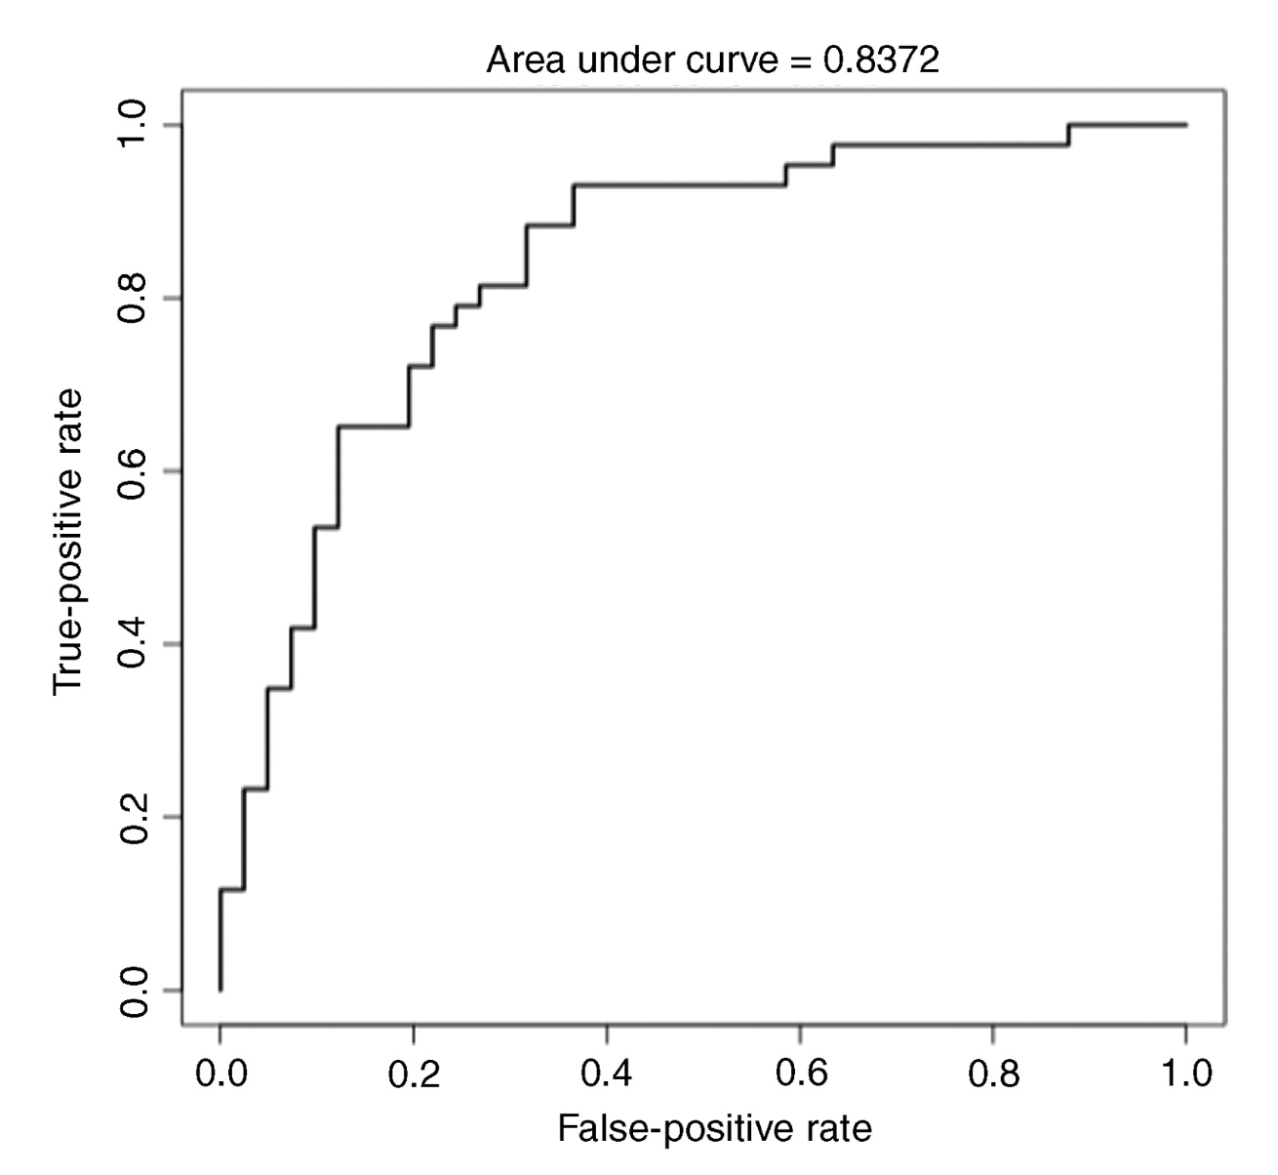
Diagnosing Pancreatic Cancer
Adult Serum Samples
43 cases, 41 controls
NMR metabolomics
AUC = 0.84 using 8 metabolites
Glutamate, acetone, 3-hydroxybutyrate, glucose, glutamine, creatine, phenylalanine, formate
AUC = 0.84
Bathe OF, Shaykhutdinov R, Kopciuk K. et al – Cancer Epid Biomark Prev. (2011) Jan;20:140-147.

Slide 54

Diagnosing Endometrial Cancer
Adult Serum Samples
40 cases, 41 controls
MS metabolomics
AUC = 0.88 using 3 metabolites
C18:2, PC ae C40:1, C6 (C4:1-DC)
Strong correlation with BMI
Pap smear AUC=0.55
Bahado-Singh R, Mandal R, Wishart DS (unpublished)

Slide 55


Predicting Flares in Ulcerative Colitis
Inflammatory Bowel Disease
Serum samples
AUC=1.0 (2 metabolites)
Inflammatory Bowel Disease
Urine Samples
AUC=0.97 (3 metabolites)
Keshteli et al. World J Gastroenterol. 2017 Jun 7;23(21):3890-3899
Keshteli et al. World J Gastroenterol. 2017 Jun 7;23(21):3890-3899

Slide 56


Predicting Maternal Health
Early Preeclampsia
First trimester maternal serum AUC = 0.99 (2 metabolites)
Late Preeclampsia
First trimester maternal serum AUC=0.96 (8 metabolites)
Bahado-Singh et al. J Matern Fetal Neonatal Med. 2012 Oct;25:1840-7.
Bahado-Singh et al. Am J Obstet Gynecol. 2013 Jan;208:58.e1-7.

Slide 57


Predicting Birth Defects
Trisomy 18
First trimester maternal serum AUC=0.91 (7 metabolites)
Trisomy 21
First trimester maternal serum AUC=0.90 (3 metabolites + Age)
Bahado-Singh et al. Am J Obstet Gynecol. 2013 209(1):65.e1-9.
Bahado-Singh et al. Am J Obstet Gynecol. 2013 209(1):65.e1-9.

Slide 58


Predicting Birth Defects
Congenital Heart Defects (CHD) Maternal Serum
AUC=0.98 (3 metabolites)
Bahado-Singh et al. Am J Obstet
Gynecol. 2014 Sep;211(3):240.e1-240.e14

Slide 59

Predicting Ovarian Cancer Survival
Adult Plasma Samples
46 short-term, 52 long-term survivors
MS metabolomics
AUC = 0.82 using 4 metabolites to discriminate long/short term survivors
Acetylcarnitine, PC(42:11), kynurenine, LPE(22:0)
Xie H. et al – Oncotarget (2017) 8: 32134-32146.

Slide 60

Predicting Cancer Cachexia
Adult Urine Samples
All with cancer
44 cachexic, 29 non-cachexic
Targeted metabolomics
AUC = 0.90 using 8 metabolites
Creatine, creatinine, branched chain AAs, glucose
Eisner R, Stretch C, Eastman T, et al. Metabolomics (2011) 7:25-34.

Slide 61

Predicting Colon Cancer (Polyps)
Adult Urine Samples
162 cases, 422 controls
NMR metabolomics
AUC = 0.75 using 14 metabolites
Butyrate, serine, methanol, beta-alanine, methylhistidine, 3-hydroxybutyrate, acetone, benzoate
Wang H, Tso V, Wong C, Sadowski D, Fedorak RN. Clin Transl Gastroenterol. (2014) Mar 20;5:e54

Slide 62
Biomarker Combinations
We have seen plenty of examples of how quantitative measurement of two or more metabolites enables improved biomarker performance and more accurate determination of biomarker thresholds
It is also possible to use other combinations of metabolites to get more biomarker variables – namely sums and ratios of metabolites
Using sums and ratios can add hundreds of additional variable to consider and these can sometimes yield even better biomarker performance

